Slide 1
Lecture 27: Holistic Technologies, Production Systems and Management Models-Typical Case Studies

Slide 2


Slide 3
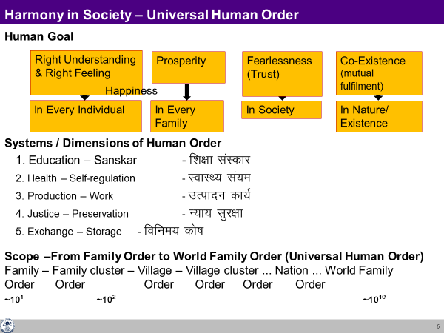
Recap
As discussed in the previous lectures, the right understanding provides us the vision for a holistic development and humane society (universal human order).
Such a model will necessitate the visualization and development of appropriate technologies, production systems and management models etc. which cater to the fulfilment of such a vision.
We will discuss some of the details in this lecture.

Slide 4
Need for a Holistic Worldview
In the present times, there is a great zeal for the development and adoption of innovative technologies and systems, tools, techniques and models which are claimed for the ‘betterment’ of society.
More and more sophistication and complexity are being added. However, most of the effort is going on under the influence of the dominant world view (limited to materialistic perception); needless to say that the holistic world-view is missing in such efforts.
As a result, both the structure as well as the use/misuse of these innovations, is often proving to be counterproductive, contrary to the long-term human welfare.
Therefore, there is a strong need to develop technologies and systems with holistic objectives governed by right understanding to render them conducive to sustainable human welfare (through humane society).

Slide 5
A Holistic Criteria for Evaluation
Catering to appropriate needs and lifestyles
Eco-friendly (cyclic / renewable and mutually enriching)
People-friendly- ensuring self-development and mutual fulfillment in human beings
User-friendly – safe, economical and enhancing human capability
In addition, these have to promote local self-sufficiency and optimal utilization of local resources and expertise.
As far as possible, priority should be for naturally available processes and systems.
In the light of these broad criteria, specific criteria for Evaluation can be broadly defined for the area of technologies, production systems and management models as follows;

Slide 6
Criteria for Technologies
Catering to real human needs (of both the body and the self)
Compatible with natural systems and cycles
Facilitating effective utilization of human body, animals, plants and other natural materials
Safe, user-friendly and conducive to health
Low cost and energy efficient
Producible with local resources and expertise as far as possible
Promoting the use of renewable energy resources
Enhancing human interaction and cooperation
Promoting decentralisation
Enhanced Durability, life cycle and recyclability of products

Slide 7
Criteria for Production Systems
In determining the type of production systems, the key questions to be answered are:
  What to produce?
  How to produce?
  For whom to produce?
  How much to produce?
  These questions (issues) have been discussed while studying about the harmony in society- human goal and its fulfillment through different dimensions of the societal system.
  So, the needs are to be characterised in consonance with the comprehensive human goal and they have to be fulfilled through human systems defined there.
All these will be decided in the context of availability of local natural resources and expertise to cater to the needs of the people for any given community.

Slide 8
Specific Criteria Production Systems
Optimal and efficient utilization of local resources and expertise, including human beings, animals, air, solar, land, water, other bio and mineral resources etc.
Economic viability and sustainability
Priority for local consumption
Matching the pattern of production with the availability/ producibility in the local environment and the pattern of consumption
Decentralized systems capable of meaningful employment of people in the community
Facilitating production by masses and not mass production in a centralized mode, to the extent possible
Promoting individual creativity and sense of accomplishment
Using people-friendly and eco-friendly technologies
Ensuring requisite quality and quantity of production
Harnessing recycling, conservation and reuse possibilities
Safe and conducive to the health of persons involved in production as well as others. Ultimately it should be conducive for self-development.

Slide 9
Criteria for Management Models
Primarily management models are to be relationship based, cooperative and ensuring justice in terms of mutual fulfillment and not coercive and exploitative. Specifically,
The whole unit working as a well-knit family
Cooperative, motivational and mutually fulfilling
Ensuring correct appraisal of human labour and skills
Targeting employer-employee satisfaction as well as consumer satisfaction and not profit maximization
Sharing of responsibility and participative mode of management
Continuous value addition (self-evolution) of the persons involved
Effectively integrating individual competencies and complementarity

Slide 10
A Critical Appraisal of the Prevailing Systems
Present-day systems have been largely developed under the influence of the dominant world view (limited to materialistic perception)
This has caused menace of resource depletion on one hand and environmental degradation manifesting in the form of pollution and global warming etc. on the other.
The other undesirable characteristics of modern technologies and systems include their centralized configurations, promotion of wastefulness, excessive transportation and substitution of human, animal and other natural resources by man-made gadgets, machines and materials (largely dependent on non-renewable enrgy sources)
It has given a lower priority (no priority) to human development and human fulfillment as far as human consciousness is concerned.

Slide 11
Learning from the Systems in Nature and Traditional Practices
To gain an insight into the holistic systems, we have a lot to learn from systems of nature and from traditional practices. Typically,
The water harvesting and storage and utilization systems through ponds and other artifacts
Traditional agricultural practices
Grain storage and food preservation practices
Systems of sharing food and shelter prevalent in social and religious institutions, e.g. langar
Traditional local remedies and health-care techniques
Yoga, Ayurveda, Naturopathy-based and other traditional healthcare systems
Family based rural enterprises
The jajmani system – relationship-based village system to ensure rural self-sufficiency
Rural craft and artisanal practices

Slide 12
Visualizing a Holistic Community Model – Working Towards it Harmony at All Levels
It is high time that we start working for actualization of the model of human order at the village level (a Holistic Community Model – gram-swarajya) in the light of right understanding.
Several groups of people have started working in this direction seriously.
As a result, many technologies and systems have been evolved even though the full-scale demonstration of such alternative ways of living is yet to emerge.
There needs to be an increasing and wide spread thrust to evolve holistic technologies and systems through dedicated R&D efforts working within the framework of right understanding
We will present some details about such a Holistic Community Model– each one of us can try to work out the further details and come up with a working model.

Slide 13
Some Topics for Case Studies
Renewable and Decentralized Energy Technologies (a) Biomass based Energy Conversion systems (b) Gadgets and Implements to facilitate efficient utilization of human muscle power and animal draught power (c) Decentralized Wind power (d) Micro hydel electro-mechanical power generation etc.
Systems for water conservation and water shed management for efficient utilization of rain water and for eco-restoration.
Technologies and architecture promoting green building materials and energy conservation
Organic/natural farming techniques
Eco-sanitation techniques for small scale decentralized sewage disposal and waste water recycling
Low cost and energy efficient technologies for small scale production systems
Humanistic organizational/management models

Slide 14
Key Takeaways
Based on right understanding, the guidelines, criteria, examples and case studies about Holistic Technologies, Production Systems and Management Models can be worked out.
We can also learn from the systems in nature and the traditional practices to evolve a holistic model of living ensuring harmony at all levels.

Slide 15
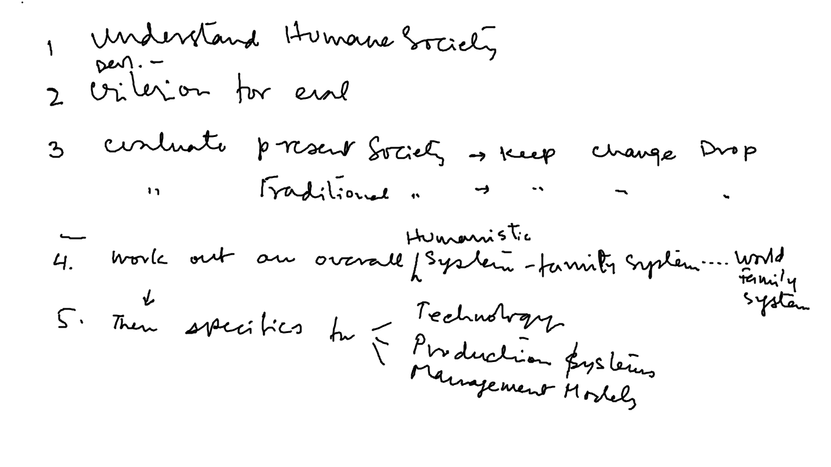
Approach to Realising a Humane Society
Starting Point Traditional Contemporary
Analyse

Slide 16
A Holistic Community Model – some details for further work
Average Land (Cultivable) Available in India per person – 0.39 Acre
Number of persons in a family = 6 -12 (Three generations in a family is desirable for the purpose of education, health, production, etc. )
Average number of persons in a family - 10
Number of family in a community is around 100 -150
Total number of people in village - around 1000
For a family of 10, Land (Cultivable) Available – 4 Acres
Average consumption of grain per person per year – 1 quintal
Average production of grain per acre - 10 quintals per acre per season/ year
Land required for grain production - 10 quintals / 10 quintal per Acre
– 1 Acre
Land required for production of oil seeds, vegetables, fruits, etc.
– 1 Acre
Land required for residence and other production activities – 0.5 Acre
Remaining land for collective planning – 1.5 Acre

Slide 17
A Holistic Community Model – some details for further work
Total land available for village – 400 Acre
Total land available for community planning – 150 Acre
Land available for Forest, cattle Grazing, water management (ponds) – 100 Acre
Roads, community building (School, Hospital), community program area (Sports, cultural functions, community hall) , collective production activity, Market place, Storage units etc. – 50 Acre

Slide 18
Way of life → technologies, production systems, management models
Relevant Research
Dr. Gopal Babu
Dr. Harsh Satya
Experiments in the Present Time
Dayalbagh, Agra
Amish (Dutch, USA)
Anastasia inspired Communities (Russia)

Slide 19
A Holistic Community Model – some details for further work
Societal activities for which families will be involved -
Types of production
  Cottage & Village industry
  Cloth
  House construction
  Pottery Etc.
Education
Health services
Inter and intra community transactions (exchange)
There is no need for involving separate family for the purpose of ensuring justice as this can ensured by the representatives of the families in the communities.

Slide 20
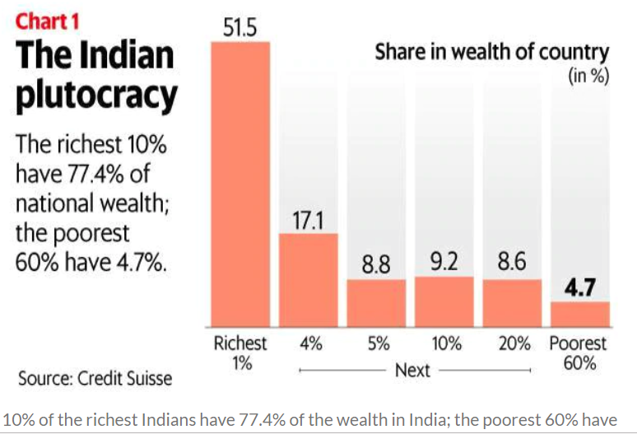
Present State – Profit Maximisation, Domination…
Packaged water Rs. 20/lit Organised sector
Wheat support price Rs. 19/kg Unorganised sector
Organised Unorganised
Employment 6-15% 85-94%
Production “value” 47% 53%

